Slide 1
Marriage Matters

Slide 2
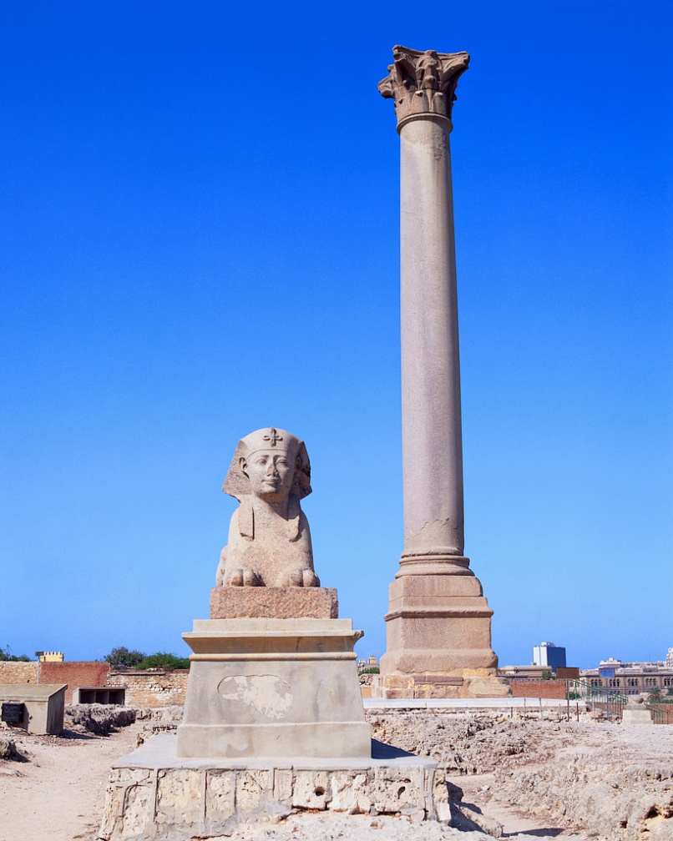
History
As old as records – through all societies – marriage was backbone of a secure environment
Purpose of Marriage
Stability of society
Children’s protection
Passing down inheritance
Common Good
Notes:
Most ancient societies needed a secure environment for the perpetuation of the species, a system of rules to handle the granting of property rights, and the protection of bloodlines. The institution of marriage handled these needs.
Purpose of marriage in ancient times also included economic reasons: heredity, passing along wealth, more hands to work the family business, whether farming, or other.
Common good was to ensure children were cared for and acted as a way to keep order in the community, especially the sexual appetites of men. For example:
Men can impregnate large number of women

Slide 3
Purpose: Relationship was not key
Assumed marriage was until death
Couple would work together – especially in an agrarian society
Having children was vital
Extended family were an integral part of the marriage
Roles of the husband and wife were defined
Notes:
Purpose of Marriage – Relationship was not key
Marriage was until death.
Couple worked together in the family business which required laborers – wife, children, extended family.
Children were vital life. During the Civil war, a couple needed to give birth to 7 children to have 2 children live to adulthood.
Infant mortality rate in 1960 was 26 babies died to every 1,000 babies born, now it is 6.9 babies die for every 1,000 born

Slide 4
Weddings today
Marry for love
Celebration costs on average $29,000
Engagement period one year or longer
Purpose: Happiness
Notes:
Weddings Today
Marry for love:
Marriage today is not as much for economic reasons as for love. We choose who we marry.
Culturally, the purpose of marriage has changed basically for happiness.
Weddings are more elaborate:
Average cost of a wedding in 2011 was $29,000 (includes ring, dress, reception and honeymoon.)
This is more than the down payment on a house
Some would say that it seems to be more about the party instead of the marriage.
Engagement:
Short engagements used to be more common (Adam and Eve was only a day)
In the 1940’s, diocese developed rules of 3 to 6 months because couples wanted to get married right away.
Now, because of cohabitation in particular, the wedding seems to be driving the engagement, instead of engagement driving the marriage.
Purpose:
Today, studies show men are more committed to children, work, local community when they are married
Men are healthier when married, as are women and children are healthier and safer.

Slide 5
Notes:
Foundation
To understand marriage, need to understand the need for a strong foundation. When the foundation is solid and strong, the structure is sound and strong.
Our foundation is Christ and His Church. To understand what Christ is asking of us in marriage, we need to look at Scripture.
Where does marriage come from? (MUR)
To understand what marriage is, the best place to start is with the human person. After all, marriage is a unique relationship between two specific persons, one man and one woman. We must ask, “What does it mean to be a human person, as a man or as a woman?”

Slide 6
What God started
Notes:
What God Started:
First, men and women are created in the image of God (see Gen 1:27). This means that they have great dignity and worth. Also, since “God is love,” (1 Jn 4:8) each person – created in God’s image – finds his or her fulfillment by loving others. Second, men and women are body-persons. The body – male or female – is an essential part of being human. Gender is not an afterthought or a mere social construct. The body shapes what it means to love as a human person. To sum up, when we think about marriage, we must think about who the human person is – created with great dignity, and called to love as a body-person, male or female.
Genesis 1: 27-28
God created mankind in his image; in the image of God he created them;
male and female - he created them. God blessed them and God said to them: Be fertile and multiply; fill the earth and subdue it. Have dominion over the fish of the sea, the birds of the air, and all the living things that crawl on the earth.
Genesis 2: 7, 18, 21-23
…then the LORD God formed the man out of the dust of the ground and blew into his nostrils the breath of life, and the man became a living being.
…The LORD God said: It is not good for the man to be alone. I will make a helper suited to him.
So the LORD God cast a deep sleep on the man, and while he was asleep, he took out one of his ribs and closed up its place with flesh. The LORD God then built the rib that he had taken from the man into a woman. When he brought her to the man, the man said: “This one, at last, is bone of my bones and flesh of my flesh; This one shall be called ‘woman,’ for out of man this one has been taken.”

Slide 7
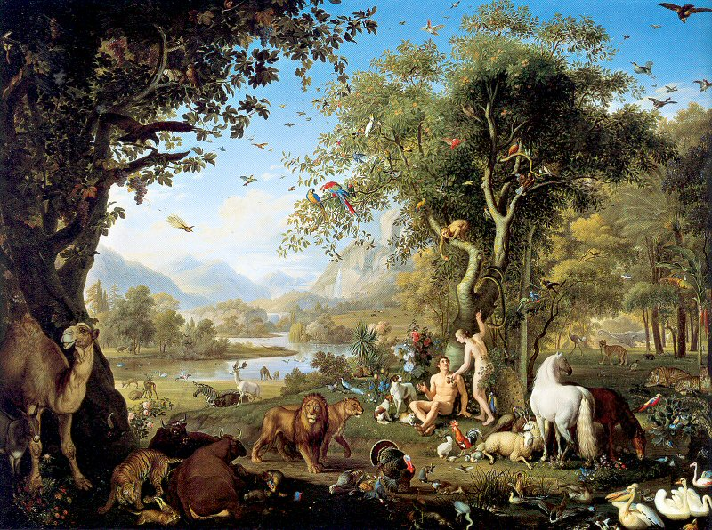
That is why a man leaves his father and mother
and clings to his wife,
and the two of them become one body.
The man and wife were both naked,
yet they felt no shame. Genesis 2:24-25
Notes:
Where does marriage come from?
“God himself is the author of marriage” (GS, no. 48). When God created human persons in his own image, as male and female, he placed in their hearts the desire, and the task, to love – to give themselves totally to another person. Marriage is one of two ways someone can make a total self-gift (the other is virginity, devoting oneself entirely to God) (see FC, no. 11). Marriage is not something thought up by human society or by any religion – rather, it springs from who the human person is, as male and female, and society and religion affirm and reinforce it. The truth of marriage is therefore accessible to everyone, regardless of their religious beliefs or lack thereof. Both faith and reason speak to the true meaning of marriage.
Genesis 2:24-25
That is why a man leaves his father and mother and clings to his wife, and the two of them become one body. The man and wife were both naked, yet they felt no shame.
A beautiful progression is illustrated in this text; first the man leaves (making a commitment to abandon his other life), then he clings (cleaves or bonds) and only then do they become one body (sexually, emotionally, spiritually, intellectually). It was in following that progression that they felt no shame.

Slide 8
So What is Marriage?
Life-long partnership
Exclusive
Indissoluble
For good of spouses and children
Notes:
What is marriage?
Marriage is the lifelong partnership of mutual and exclusive fidelity between a man and a woman ordered by its very nature to the good of the spouses and the procreation and education of children (see CCC, no. 1601; CIC, can. 1055.1; GS, no. 48). The bond of marriage is indissoluble – that is, it lasts “until death do us part.” At the heart of married love is the total gift of self that husband and wife freely offer to each other. Because of their sexual difference, husband and wife can truly become “one flesh” and can give to each other “the reality of children, who are a living reflection of their love” (FC, no. 14).
Marriage between a baptized man and a baptized woman is a sacrament. This means that the bond between husband and wife is a visible sign of the sacrificial love of Christ for his Church. As a sacrament, marriage gives spouses the grace they need to love each other generously, in imitation of Christ.

Slide 9
Marriage is Made for Life
Notes:
Marriage is made for life (see Gn 1:27-28).12 It is made to be open to the gift of the child
and to serve life in manifold ways. No other human institution on the face of the planet
has been naturally made to serve the purposes for which marriage has been designed—
the union of a man and a woman as the basis of the family, a union ordered to the spouses’
good and to the procreation and education of children.
Love and life are built into the very essence of marriage. In fact, love and life are inseparable.
Authentic spousal love is always open to the gift of the other and the gift of life, and
openness to life manifests true spousal love. Being open to receiving the gift of a child is
not arbitrary or extrinsic to marriage. It’s not an extra. It’s what marriage is. It is part and
parcel of what marriage is about, as the total gift of self between husband and wife. “A
child does not come from outside as something added on to the mutual love of the spouses,
but springs from the very heart of that mutual giving, as its fruit and fulfillment.”

Slide 10
“Children are a gift and a blessing.”

Slide 11
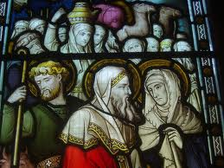
Sarah & Abraham
Obeyed God even with only son, Isaac
Descendents as many as the sands on the seashore and the stars in the heaven….
Genesis 22
Notes:
11
Sarah and Abraham
Abraham didn’t have a child until very old.
Genesis 20:2, 5
Sarah became pregnant and bore Abraham a son in his old age, at the set time that God had stated…. Abraham was a hundred years old when his son Isaac was born to him.
Genesis 22:1-2, 10-12, 17-18
Some time afterward, God put Abraham to the test and said to him: Abraham! “Here I am!” he replied. Then God said: Take your son Isaac, your only one, whom you love, and go to the land of Moriah. There offer him up as a burnt offering on one of the heights that I will point out to you.
…Then Abraham reached out and took the knife to slaughter his son. But the angel of the LORD called to him from heaven, “Abraham, Abraham!” “Here I am,” he answered. “Do not lay your hand on the boy,” said the angel. “Do not do the least thing to him. For now I know that you fear God, since you did not withhold from me your son, your only one.”
…that because you acted as you did in not withholding from me your son, your only one, I will bless you and make your descendants as countless as the stars of the sky and the sands of the seashore; your descendants will take possession of the gates of their enemies, and in your descendants all the nations of the earth will find blessing, because you obeyed my command.

Slide 12
Marriage Matters so much, that God began all of creation around marriage and children

Slide 13
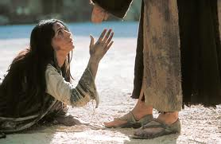
Pharisees asked “Is it lawful for a man to divorce his wife?”
Notes:
Matthew – 5:27 This was a very tricky question – Law of Old testament allowed man to divorce his wife if woman committed adultery
Big deal to be faithful
FOCCUS “I could not remained marriage to my future spouse if he or she was every unfaithful to me.”

Slide 14
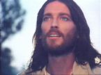
Jesus Replies
“Have you not read that from the beginning the Creator 'made them male and female,' and said, 'For this reason a man shall leave his father and mother and be joined to his wife, and the two shall become one flesh'? So they are no longer two, but one flesh. Therefore what God has joined together, no human being must separate.” Matthew 19:4-6
Notes:
Jesus didn’t say: man and man or woman and woman
Becoming one flesh – only can happen physically between man and woman
Come together forever – Jesus makes that point twice – because even the apostles had a hard time understanding
These are ideals. We don’t always live up to them. Sometimes people choose one another outside God’s will. Need sacrament & grace

Slide 15
Marriage Matters enough that Jesus elevated it to a sacrament

Slide 16
Male-Female Complementarity
Marriage does not exist merely for the reproduction of another member of the species,
but for the creation of a communion of persons.

Slide 17
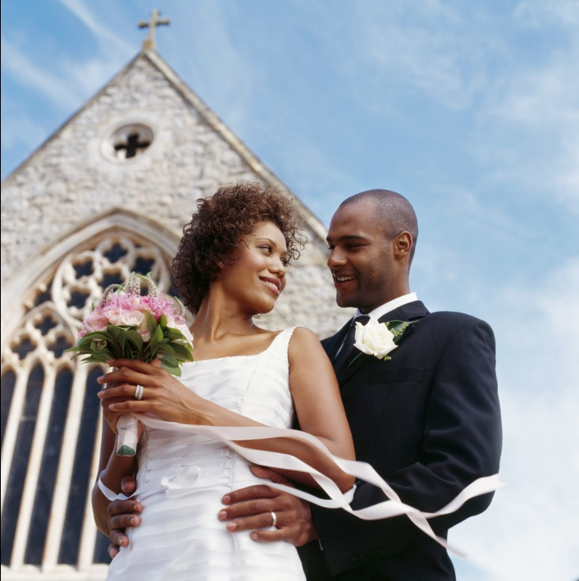
Two Ends of Marriage
Unitive (228)
Procreative & Educative
Married love itself is ordered to the procreation and education of children, for, after all, the first command given Adam and Eve is “be fertile and multiply” Gn1:28

Slide 18
Majority of Americans (89%) are married by age of 30

Slide 19
Married People are Healthier & Happier
Married men earn 10% - 40% more money
Married people live longer as well and spend less time in hospital.
Single men 2 x’s more, and 25 % say their drinking causes problems.
Notes:
Single men have mortality rates 250% higher than married men.
Single women have mortality rates 50% higher than married women
Having a spouse can decrease your risk for dying from cancer as much as knocking ten years off your life.
Single people spend longer in the hospital, and have a greater risk of dying after surgery
Single men drink twice as much as married men, and one out of four say their drinking causes problems.

Slide 20
Married People are Healthier & Happier
Have sex Twice a week
Married People (40%)
Single and cohabitating (20-25%)
More Emotional & Physically Sexually Satisfied
Married Women (Over 40%)
Single women (30%)
Married Men (50%)
Cohabitating men (38%)
86% of the married people who rated their marriages as unhappy who stayed together rated the marriage as having improved 5 years later.
Notes:
40% of married people have sex twice a week, compared to 20-25% of single and cohabitating men and women.
Over 40% of married women said their sex life was emotionally and physically satisfying, compared to about 30% of single women.
For men, it’s 50% of married men are physically and emotionally contents versus 38% of cohabitating men
86% of the married people who rated their marriages as unhappy who stayed together rated the marriage as having improved five years later.

Slide 21
Marriage Matters to our society as a whole

Slide 22
Children
"By its very nature …marriage … is ordered to the procreation and education of the offspring
Its crowning glory
Children are the supreme gift of marriage and contribute greatly to the good of the parents themselves. CCC 1652

Slide 23
Made for Life
http://www.marriageuniqueforareason.org/children-video/
Notes:
Kristen A. Moore et al., Marriage from a Child's Perspective: How Does Family Structure. Affect Children, and What Can We Do about It? at Kristen A. Moore et al., Marriage from a Child's Perspective: How Does Family Structure. Affect Children, and What Can We Do about It? at http://www.childtrends.org/files/MarriageRB602.pdf.
23

Slide 24
Marriage Matters to Children

Slide 25
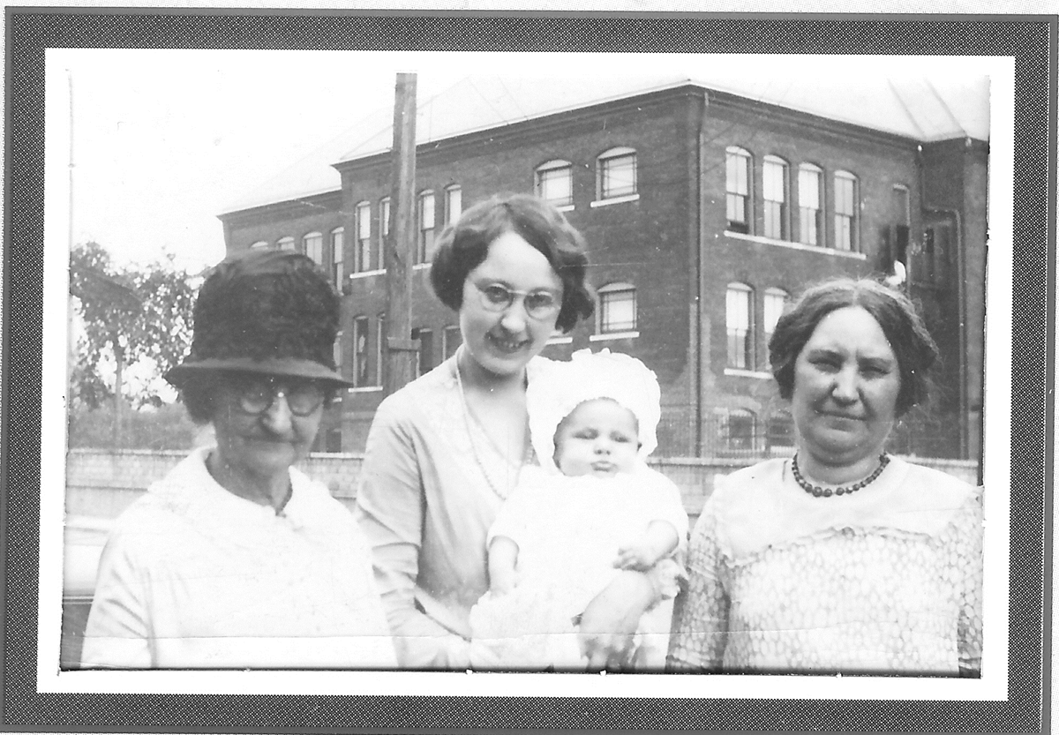
Why would one couple’s marriage matter to anyone else?
Research has shown that we affect at least five generations

Slide 26
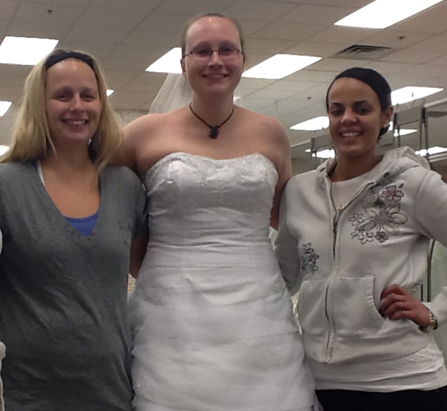
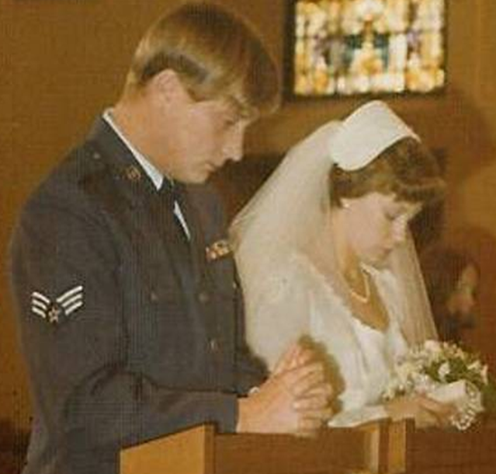

Slide 27
Marriage Matters to our own families

Slide 28
Marriage is Fulfilled in the Kingdom of God
[Marriage] is a sign of the Kingdom because the love of Christ moves the married couple to ever greater heights of love. (1097)
Christian married love is a preparation for eternal-life. (1099)

Slide 29
Marriage Matters
So much, that God began all of creation around marriage and children
Enough that Jesus elevated it to a sacrament
To our society as a whole
To Children
And to our own families

